Slide 1
Topic : Drowsiness Detection System
Group members:
Muhammad Najam-ul-Hasan(2k18-bscs-236)
(Group Leader)
Ahmad Sohial (2k18-bscs-227)
Muhammad Awais (2k18-bscs-229)
Mudasir hussian (2k18-bscs-232)
Areej Zainab (2k18-bscs-234)
Burhan Kamran (2k18-bscs-228)

Slide 2
BackGround
Artificial intelligence is not a new word and not a new technology for researchers. this technology is much older than you would imagine. even there are the myths of mechanical men in ancient greek and egyptian myths. following are some milestones in the history of ai which defines the journey from the ai generation to till date development.

Slide 3
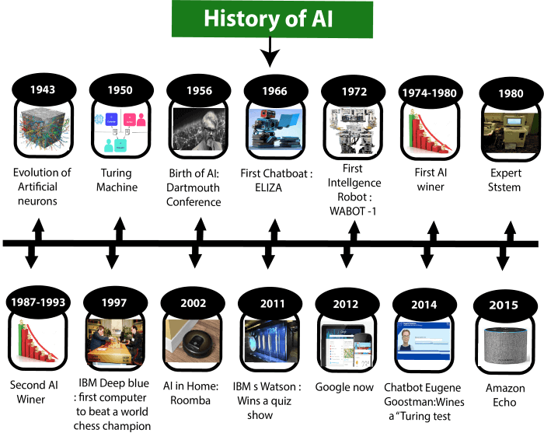

Slide 4
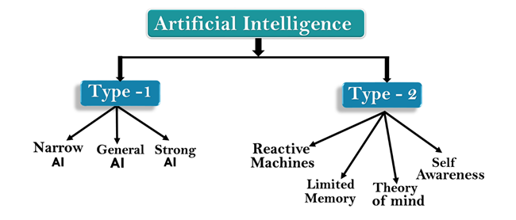
Types of Artificial Intelligence:

Slide 5

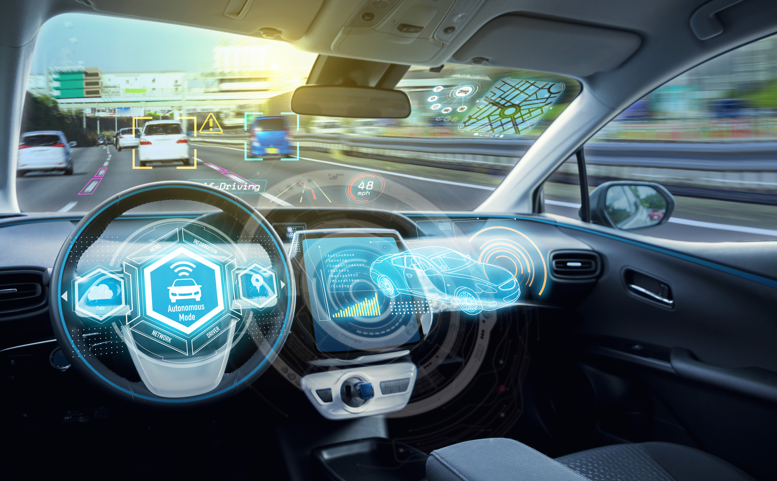
WHERE AI IS USING NOW A DAY??
Smartphones. If you are reading this article, you most probably own a smartphone. ...
Smart Cars and Drones. ...
Social Media Feeds. ...
Music and Media Streaming Services. ...
Video Games. ...
Online Ads Network. ...
Navigation and Travel. ...
Banking and Finance.

Slide 6
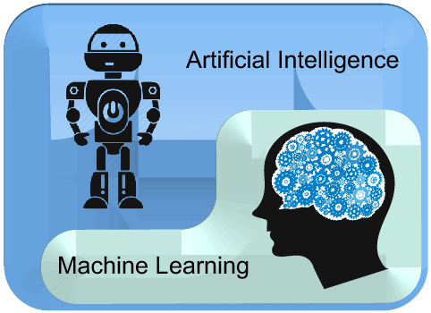
Ai is a bigger concept to create intelligent machines that can simulate human thinking capability and behavior, whereas, machine learning is an application or subset of ai that allows machines to learn from data without being programmed explicitly

Slide 7
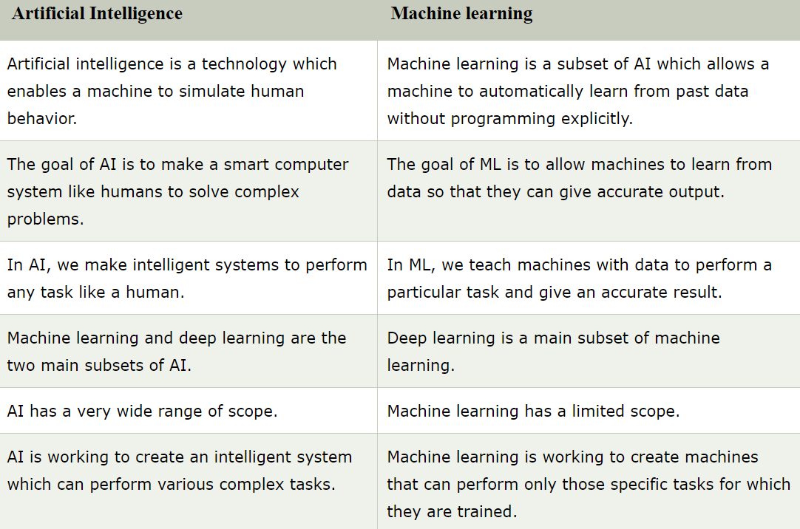

Slide 8

Supervised learning
Supervised learning, as the name indicates, has the presence of a supervisor as a teacher. Basically supervised learning is when we teach or train the machine using data that is well labeled.
For instance, suppose you are given a basket filled with different kinds of fruits. Now the first step is to train the machine with all different fruits one by one like this:

Slide 9
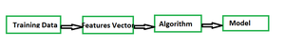
Advantages And Disadvantages Of Supervised Learning
Advantages:-
Supervised learning allows collecting data and produces data output from previous experiences.
Helps to optimize performance criteria with the help of experience.
Supervised machine learning helps to solve various types of real-world computation problems.
Disadvantages:-
classifying big data can be challenging.
Training for supervised learning needs a lot of computation time. So, it requires a lot of time.

Slide 10
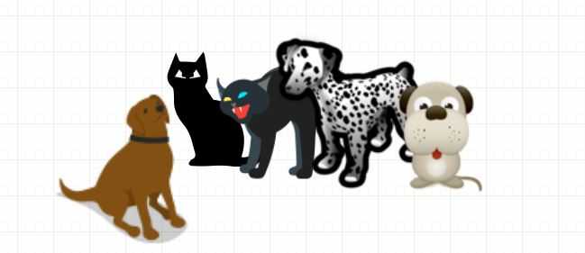
Unsupervised Learning
Unsupervised learning is the training of a machine using information that is neither classified nor labeled and allowing the algorithm to act on that information without guidance. Here the task of the machine is to group unsorted information according to similarities, patterns, and differences without any prior training of data.
Unlike supervised learning, no teacher is provided that means no training will be given to the machine. Therefore the machine is restricted to find the hidden structure in unlabeled data by itself.
For instance, suppose it is given an image having
both dogs and cats which it has never seen.

Slide 11
Advantages And Disadvantages Of Unsupervised Learning
Disadvantages
This is the perfect tool for data scientists, as unsupervised learning can help to understand raw data.
It is very helpful in finding patterns in data, which are not possible to find using normal methods.
Advantages
The result might be less accurate as we do not have any input data to train from.
The model is learning from raw data without any prior knowledge.

Slide 12
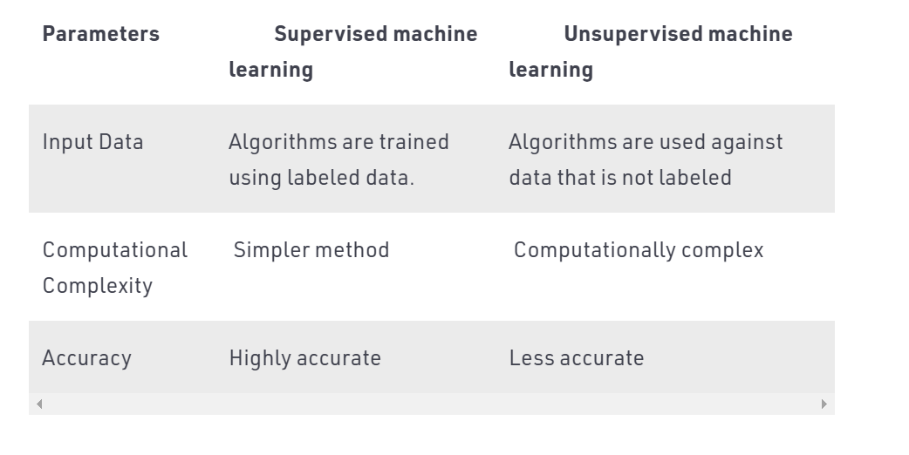
Supervised Vs. Unsupervised Machine Learning

Slide 13
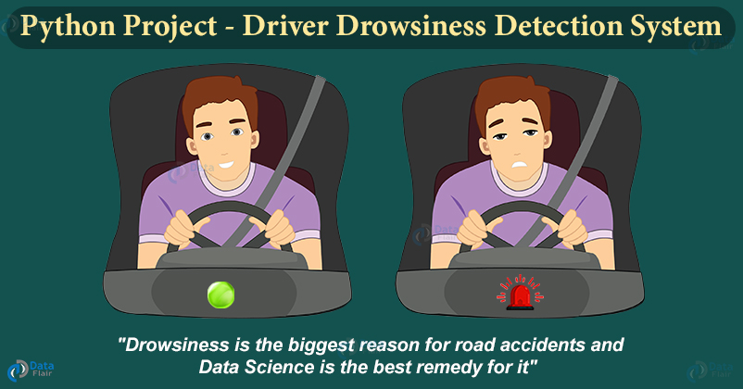
Advantages of this project
According to the latest WHO data published in 2018 road traffic accidents deaths in pakistan reached 30,046 or 2.42% of total deaths. The age adjusted death rate is 17.12 per 100,000 of population ranks pakistan #95 in the world.
So it help to prevent accidents.

Slide 14
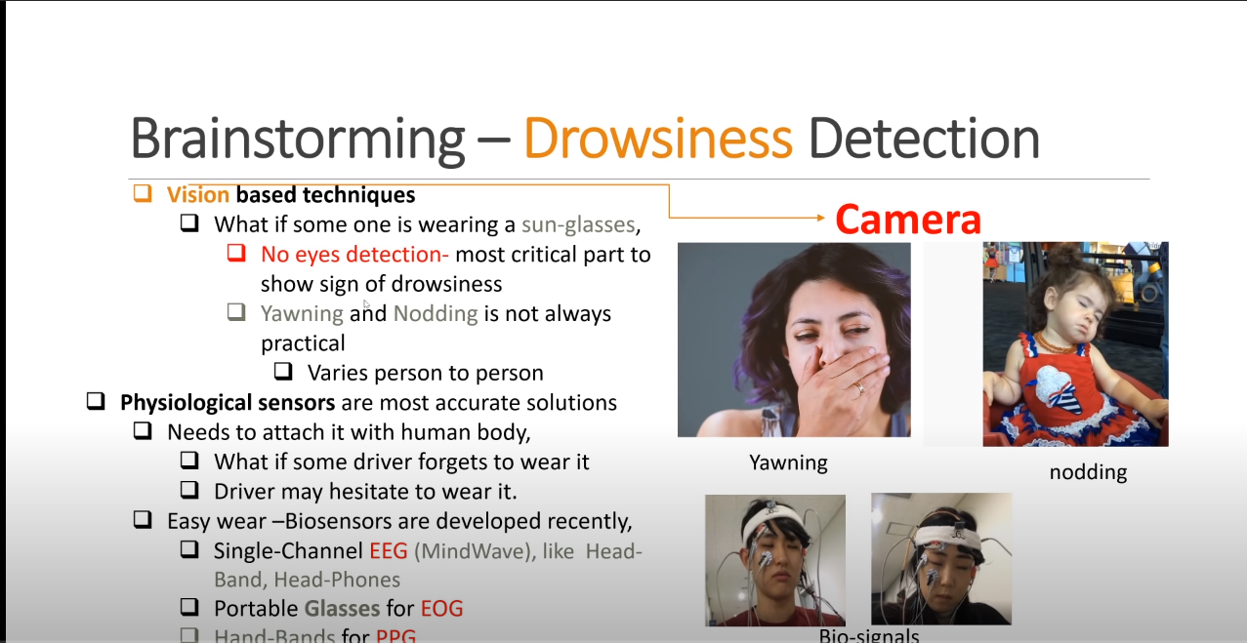
BACKGROUND OF OUR PROJECT

Slide 15
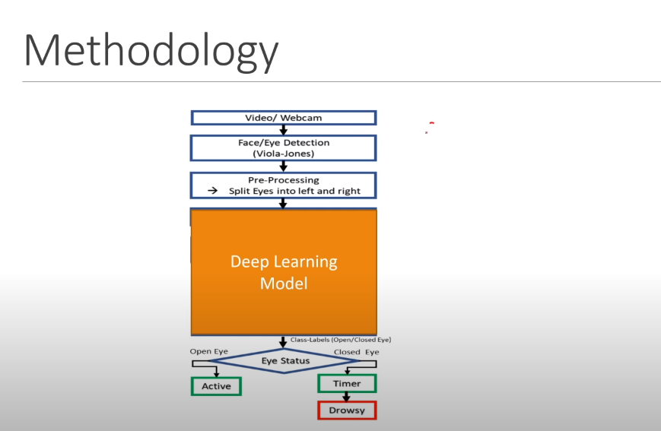

Slide 16
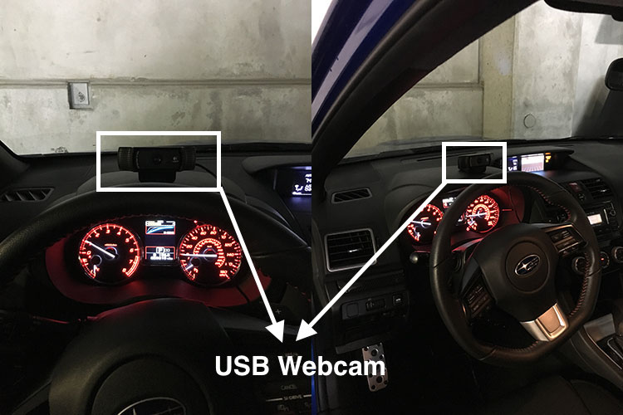
So We Use Camera on dashboard

Slide 17
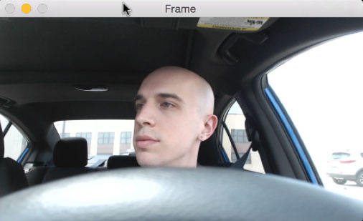
First, we’ll setup a camera that monitors a stream for faces

Slide 18
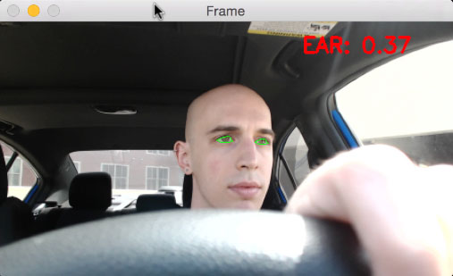
If a face is found, we apply facial landmark detection and extract the eye regions:

Slide 19
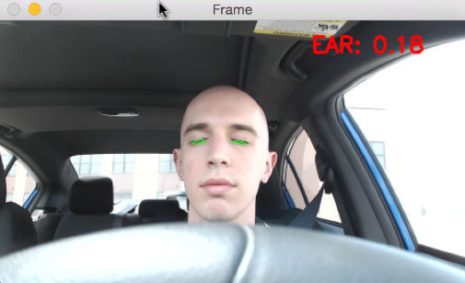
Now that we have the eye regions, we can compute the eye aspect ratio to determine if the eyes are closed:

Slide 20
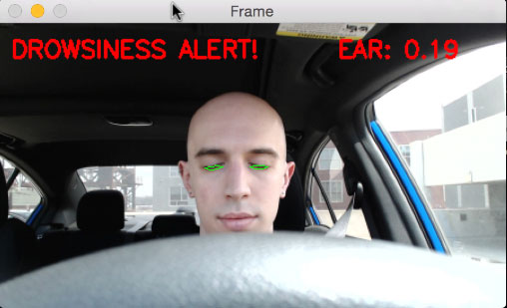
If the eye aspect ratio indicates that the eyes have been closed for a sufficiently long enough amount of time, we’ll sound an alarm to wake up the driver:

Slide 21
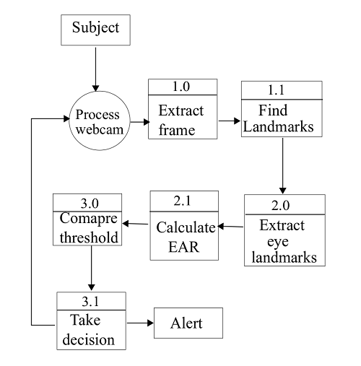
data flow diagram (DFD) of the system.

Slide 22
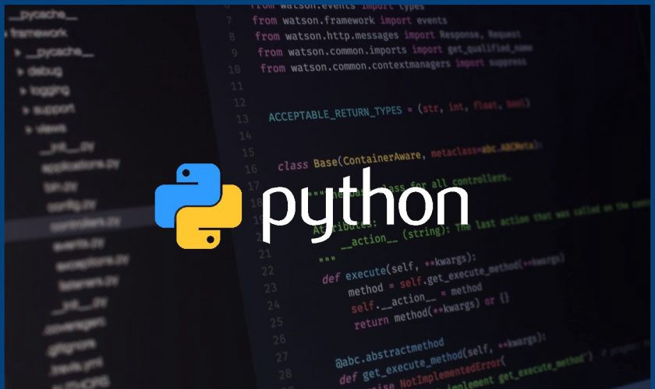
Language

Slide 23
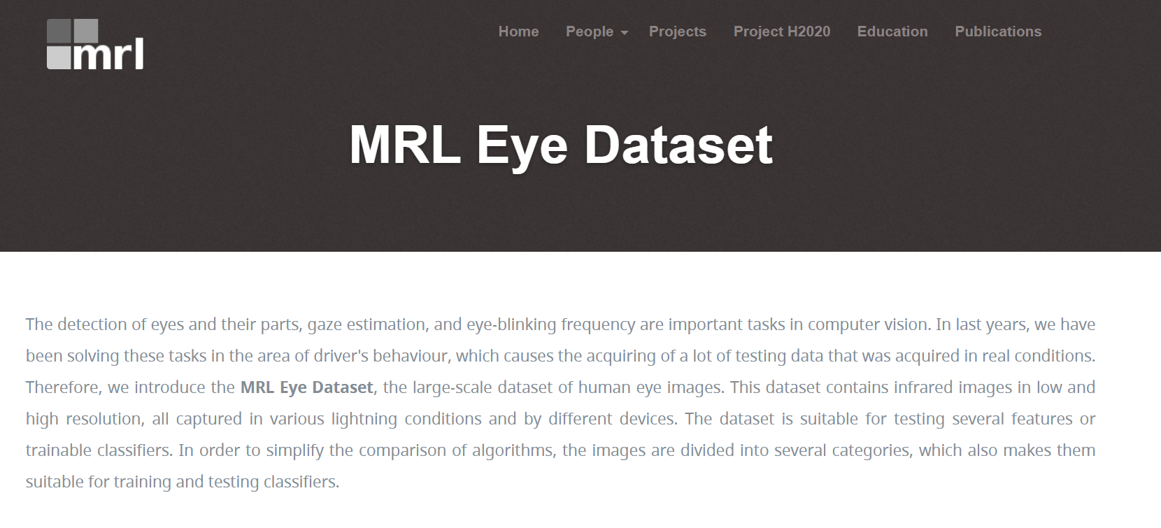
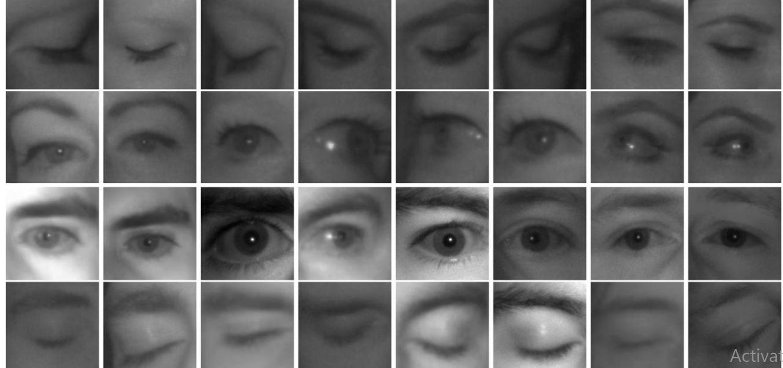
DATASET We Use

Slide 24

Platform to write code
The Jupyter Notebook is an open-source web application that allows you to create and share documents that contain live code, equations, visualizations and narrative text.

Slide 25
TOOLS
Scipy
Imutils package
Playsound library
Dlib library

Slide 26
Scipy
Scipy installed if you intend on doing any work in the computer vision, image processing, or machine learning space).
Scipy contains modules for optimization, linear algebra, integration, interpolation, special functions,

Slide 27
Imutils package
Computer vision and image processing functions to make working with opencv easier.

Slide 28
Playsound library
Playsound library, a pure python, cross-platform implementation for playing simple sounds.

Slide 29
Dlib library
Dlib is a modern C++ toolkit containing machine learning algorithms and tools for creating complex software in C++ to solve real world problems
. I have majorly used dlib for face detection and facial landmark detection.

Slide 30

Building the drowsiness detector with open cv

Slide 31
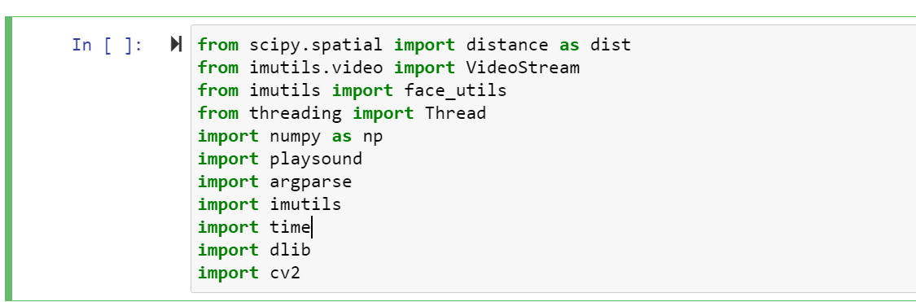
Drowsiness detection with Open CV

Slide 32
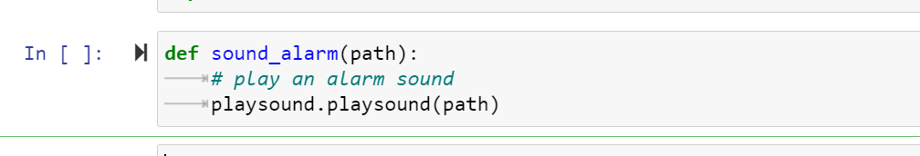
We need to define our sound_alarm function which accepts a path to an audio file residing on disk and then plays the file:

Slide 33
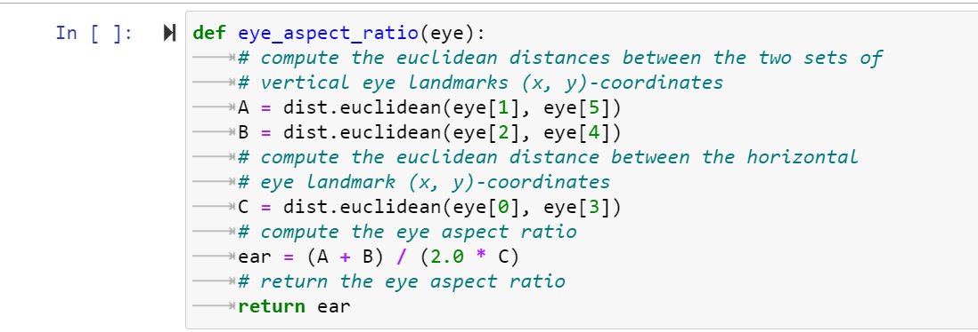
We also need to define the eye_aspect_ratio function which is used to compute the ratio of distances between the vertical eye landmarks and the distances between the horizontal eye landmarks:

Slide 34
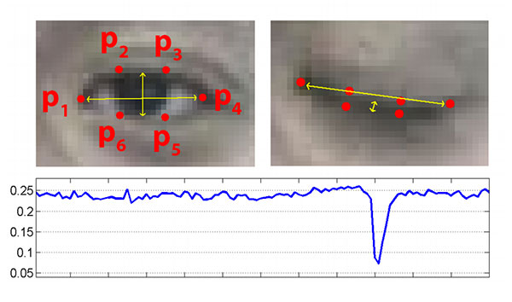
Top-left: A visualization of eye landmarks when then the eye is open. Top-right: eye landmarks when the eye is closed. Bottom: plotting the eye aspect ratio over time. The dip in the eye aspect ratio indicates a blink

Slide 35
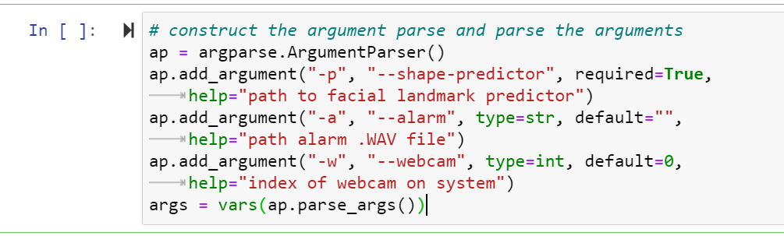
Our drowsiness detector requires one command line argument followed by two optional ones,
--shape-predictor
: This is the path to dlib’s pre-trained facial landmark detector
--alarm
: Here you can optionally specify the path to an input audio file to be used as an alarm.
--webcam
: This integer controls the index of your built-in webcam/USB camera

Slide 36
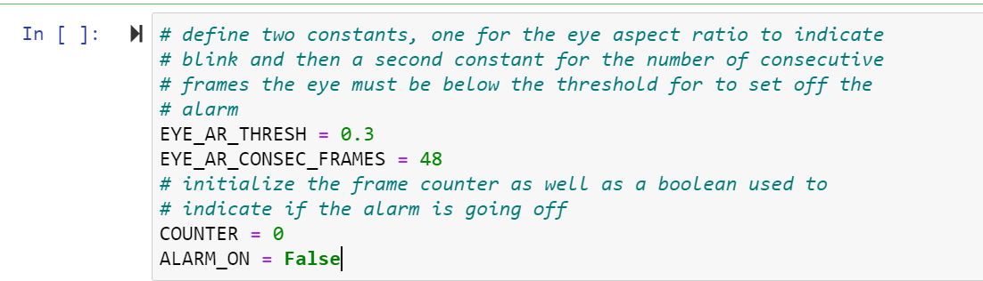
the EYE_AR_THRESH
. If the eye aspect ratio falls below this threshold, we’ll start counting the number of frames the person has closed their eyes for.
EYE_AR_CONSEC_FRAMES
.If the number of frames the person has closed their eyes in exceeds EYE_AR_CONSEC_FRAMES
(we’ll sound an alarm).
COUNTER
, the total number of consecutive frames where the eye aspect ratio is below EYE_AR_THRESH

Slide 37
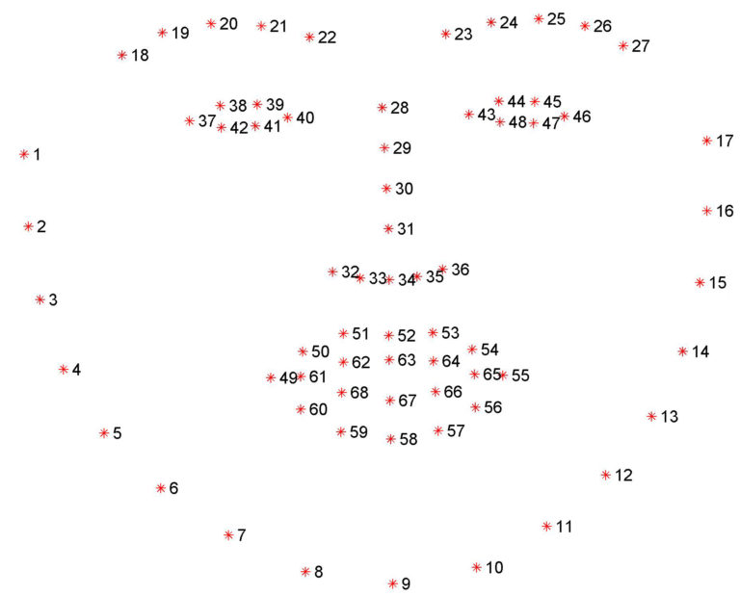
Facial landmark prediction is the process of localizing key facial structures on a face, including the eyes, eyebrows, nose, mouth, and jawline.

Slide 38
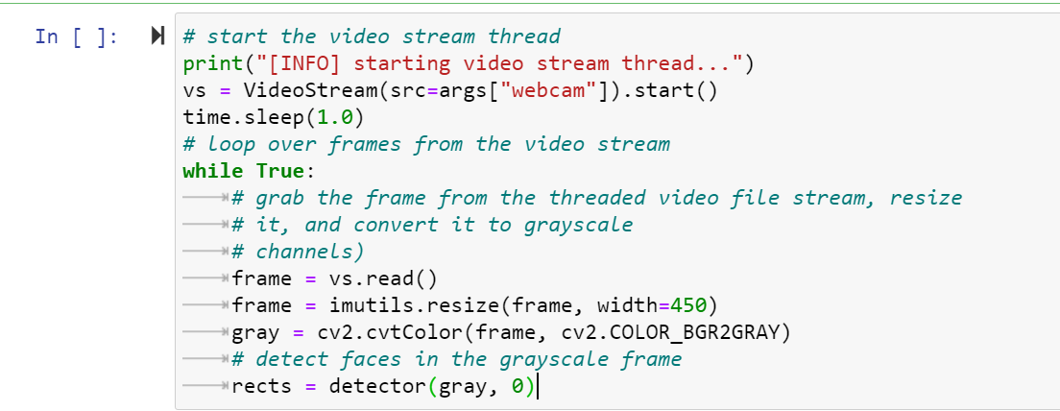
-VideoStream
using the supplied --webcam
index.
-we start looping over frames in our video stream
-frame
, which we then preprocess by resizing it to have a width of 450 pixels and converting it to grayscale
dlib’s face detector to find and locate the face(s) in the image.

Slide 39
FUTURE WORK
For future work, we will extend our application to detect drowsiness even when the subject is using sunglass or color spectacles. Another future study can be done to detect drowsiness is to develop a system which can detect drowsiness in the night or with very low illumination.
Real-time data are always unconstrained and with unconstrained nature of the subject/driver, it becomes very difficult to find facial landmarks. Therefore, to overcome this constraint a more reliable application can be developed which can detect face even when user/subject is not friendly.

Slide 40
To increase the sensitivity of application, a multimodal system can be developed which not uses only eye feature, but also facial expression, mouth feature and combine all features to make the decision where driver/subject is sleeping or not.

